Slide 1
FRIDA DEMO ON uncrackable1.apk

Slide 2
demos
1. Run the emulator
> emulator -avd <device-name>
2. Run the frida-server
> adb shell “/data/local/tmp/frida-server &”
3. Check the frida-server
> frida-ps -U
4. Install the apk
> adb install <apk-name.apk>
5. Prepare the javascript-based frida script
6. Find the packages name of targeted app
> adb shell pm list packages
7. Inject the app
> frida -U -l <js-script.js> -f <com.name.name>
8. Observe the behavior of the app etc

Slide 3
LOADME CHALLENGE

Slide 4
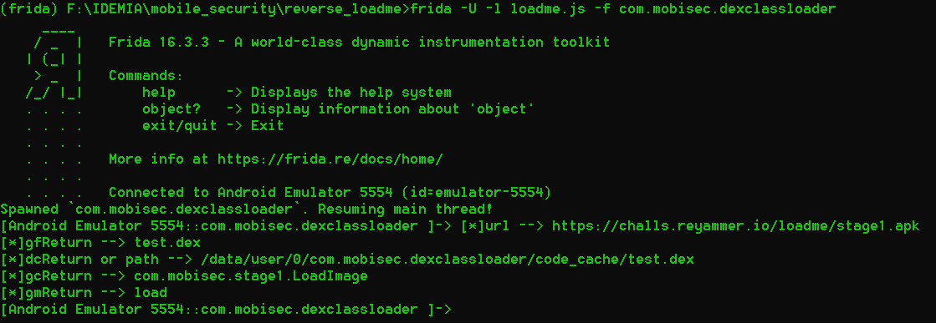
EXPLORE 1

